Slide 1

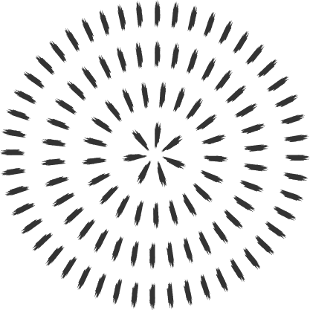
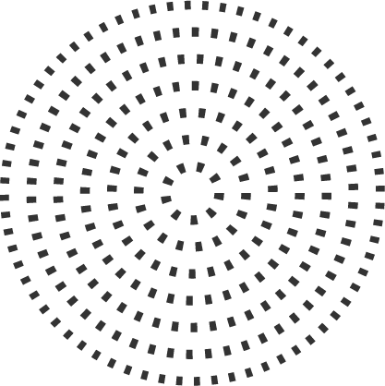
Data Types in C programming with source code

Slide 2
Data Types
It is an attribute of data which tells the compiler or interpreter how the programmer intends to use the data.
In c, data types constitute the semantic and characteristics of storage of data elements.
They are expressed in language syntax in the form of memory locations and variables.
It determines the type of operations or method of processing of data elements.

Slide 3
Data Types in C
Primary
Derived
User-Defined
Boolean
Array
Enum
Integer
Structure
References
Character
Union
Pointer
Float
Type Void

Slide 4
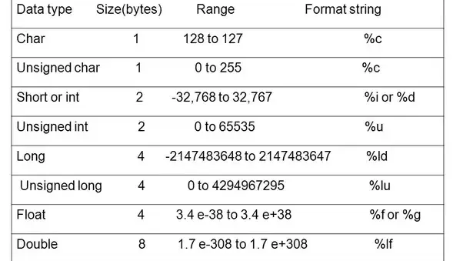

Slide 5
Basic example of primary data type
#include <stdio.h>
int main() {
int a = 4000; // positive integer data type
float b = 5.2324; // float data type
char c = 'Z'; // char data type
long d = 41657; // long positive integer data type
long e = -21556; // long -ve integer data type
int f = -185; // -ve integer data type
short g = 130; // short +ve integer data type
short h = -130; // short -ve integer data type
double i = 4.1234567890; // double float data type
float j = -3.55; // float data type
}

Slide 6
Example program to add two values of a particular data type.
#include <stdio.h> int main() { int number1, number2, sum; printf("Enter two integers: "); scanf("%d %d", &number1, &number2); // calculating sum sum = number1 + number2; printf("%d + %d = %d", number1, number2, sum); return 0; }

Slide 7
What is derived data types and why it is needed?
Derived from built-in data types
Limited number of problems are solved using primary data types
Help to solve complex problems

Slide 8

C supports three derived data types:
Data Types | Description
Arrays | Arrays are sequences of data items having homogeneous values. They have adjacent memory locations to store values.
References | Function pointers allow referencing functions with a particular signature.
Pointers | These are powerful C features which are used to access the memory and deal with their addresses.

Slide 9
Array Pointer and Reference example
int mark[5] = {19, 10, 8, 17, 9};
int* pc, c; c = 5; pc = &c; printf("%d", *pc); // Output: 5
#include<stdio.h>
void change(int num) {
printf("Before adding value inside function num=%d \n",num);
num=num+100;
printf("After adding value inside function num=%d \n", num);
}
int main() {
int x=100;
printf("Before function call x=%d \n", x);
change(x);//passing value in function
printf("After function call x=%d \n", x);
return 0;
}

Slide 10
User defined data type
C allows the feature called type definition which allows programmers to define their identifier that would represent an existing data type. There are three such types:
Data Types | Description
Structure | It is a package of variables of different types under a single name. This is done to handle data efficiently. "struct" keyword is used to define a structure.
Union | These allow storing various data types in the same memory location. Programmers can define a union with different members, but only a single member can contain a value at a given time. It is used for
Enum | Enumeration is a special data type that consists of integral constants, and each of them is assigned with a specific name. "enum" keyword is used to define the enumerated data type.

Slide 11
Structure
Collection of one or more related variables of different data types, grouped under a single name
For example: In a Library, each book is an object, and its characteristics like title, author, no of pages, price are grouped and represented by one record. The characteristics are different types and grouped under a aggregate variable of different types. A record is group of fields and each field represents one characteristic. In C, a record is implemented with a derived data type called structure. The characteristics of record are called the members of the structure.

Slide 12
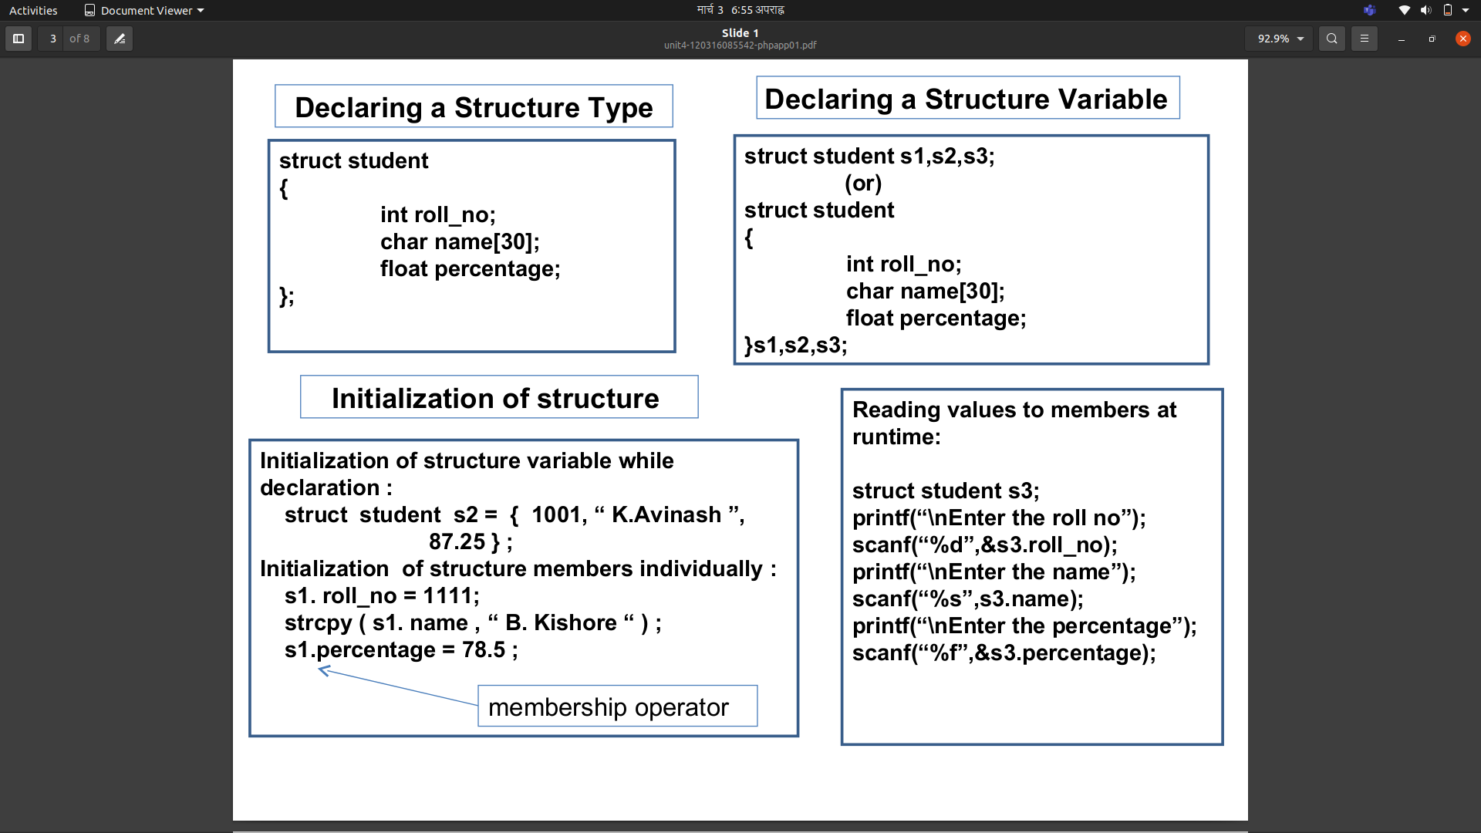

Slide 13
Union
A union is a special data type available in C that allows to store different data types in the same memory location.
Example #include <stdio.h> #include <string.h> union Data { int i; float f; char str[20]; }; int main( ) { union Data data; printf( "Memory size occupied by data : %d\n", sizeof(data)); return 0; }

Slide 14
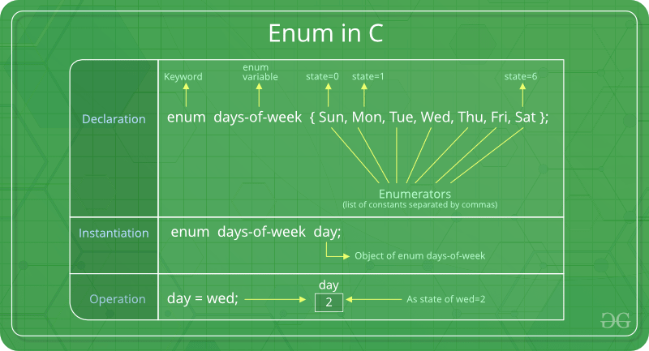
Enum
It is mainly used to assign names to integral constants, the names make a program easy to read and maintain.
Example:
#include<stdio.h>
enum week{Mon, Tue, Wed, Thur, Fri, Sat, Sun};
int main()
{
enum week day;
day = Wed;
printf("%d",day);
return 0;
}

Slide 15
References
C pointers (With examples). (n.d.). Programiz: Learn to Code for Free. https://www.programiz.com/c-programming/c-pointers
C unions (With examples). (n.d.). Programiz: Learn to Code for Free. https://www.programiz.com/c-programming/c-unions
Data types in C. (2015, December 21). Share and Discover Knowledge on SlideShare. https://www.slideshare.net/TarunSharma24/data-types-in-c-56342387
Enumeration (or enum) in C. (2018, December 21). GeeksforGeeks. https://www.geeksforgeeks.org/enumeration-enum-c/
UNIT-3: Functions objectives. (1). SlidePlayer - Upload and Share your PowerPoint presentations. https://slideplayer.com/slide/12044744/

